Slide 1

AGRI-PREDICT
Crop Yields Prediction from Historical Agricultural Data
Explore how analyzing historical agricultural data can unlock the secrets to enhanced crop production and sustainable farming practices.
GROUP : 13
GROUP DETAILS:
SURYA TEJ | 2310030039
NAKSHATRA | 2310030142
DEVINENI HASINI | 2310030331
VYSHNAVI | 2310030445
BHAVISHYA | 2310030055

Slide 2
Problem Statement
Accurate prediction of crop yield is a major challenge in agriculture due to the influence of multiple uncertain factors such as:
Weather conditions
Soil properties
Farming practices.
Traditional methods of yield estimation are mostly manual and experience based, which often lead to inaccurate and unreliable results.
In this project, real-world agricultural and weather data will be used to build an automated, data-driven system that can analyze large datasets and predict crop yield accurately to support better agricultural planning and decision making.

Slide 3
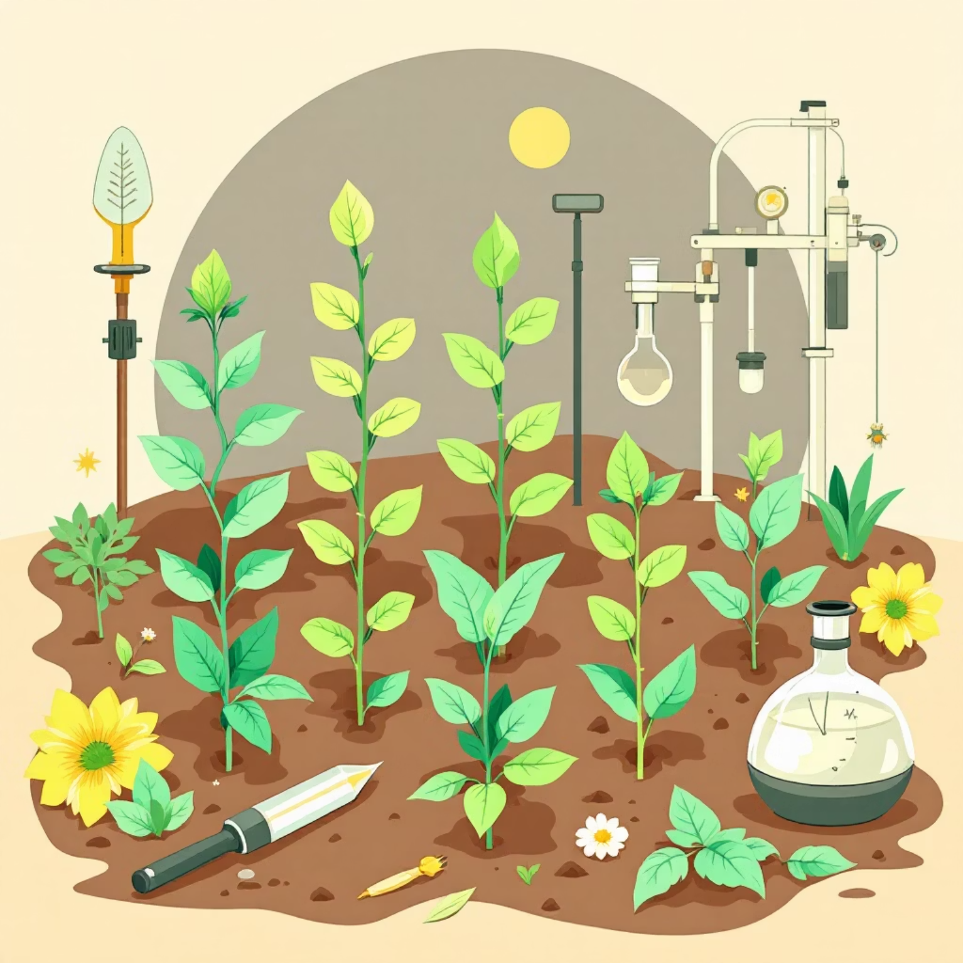
Project Description: Data-Driven Agriculture
Crop yield prediction system that uses historical agricultural and weather data to estimate crop production accurately. The project applies machine learning techniques to analyze factors such as crop type, rainfall, temperature, soil properties, and cultivated area. By integrating data engineering and artificial intelligence concepts, the system provides a scalable and efficient solution for agricultural decision support and planning.

Slide 4


Key Factors Identified
Soil Factors
pH, NPK, Soil type, Fertility
Climate Factors
Temperature, Rainfall, Humidity, Sunlight
Water Availability
Irrigation source
Land & Historical Factors
Past crops, topography

Slide 5








Objectives
Main Objective
Predict Future Trends
To collect real-world data related to soil type, rainfall, temperature, humidity, crop type, and cultivated area
To train a machine learning model using these input parameters
Optimize Farming
Promote Sustainability
Provide data-backed recommendations for improved agricultural output.
Advise on practices that enhance yield while preserving natural resources.

Slide 6
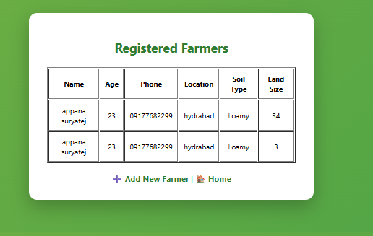
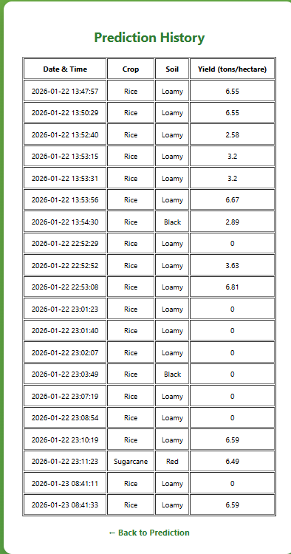
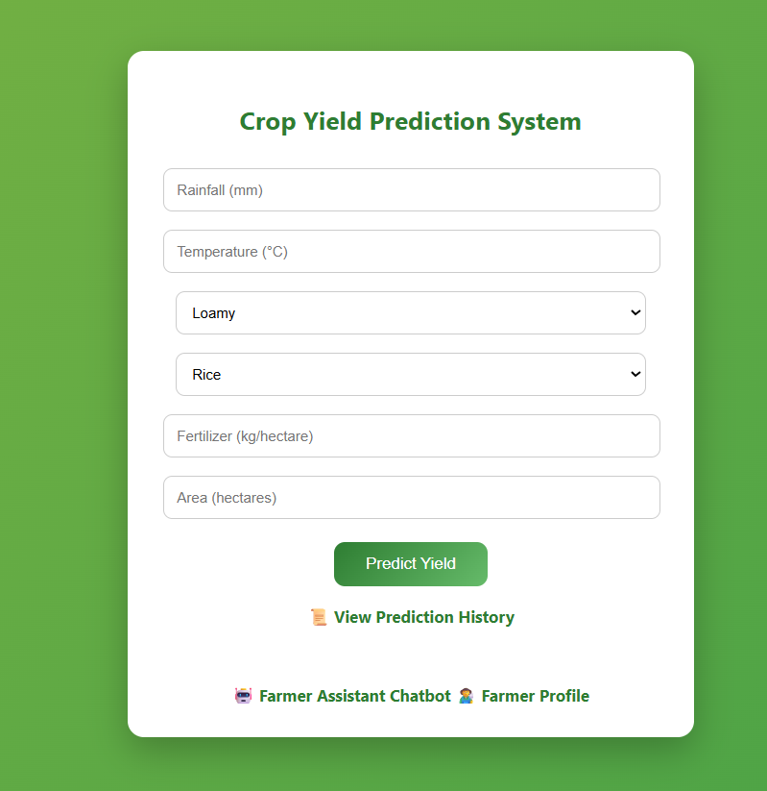
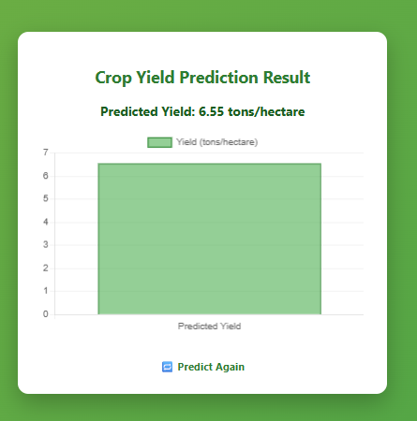
Outcomes

Slide 7

Thank You
We hope this project provides valuable insights into optimizing crop yield for a more sustainable and abundant future in agriculture.

